Slide 1
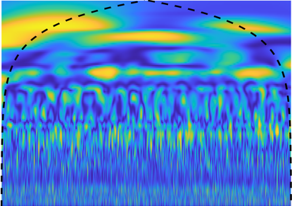
Fc_4
Fully-Connected
Neural Network
Fc_3
Fully-Connected
Neural Network
ReLU Activation
Conv_1
Convolution
(3x3) Kernel
Valid Padding
Conv_2
Convolution
(3x3) Kernel
Valid Padding
Conv_3
Convolution
(3x3) Kernel
Valid Padding
Max- Pooling
(2x2)
Max- Pooling
(2x2)
Max- Pooling
(2x2)
Leak
Non-Leak
Input
n1 Channel
n1 Channel
n2 Channel
n2 Channel
Flattened
n3 Units
Output
Feature Extraction
Classification

